Slide 1
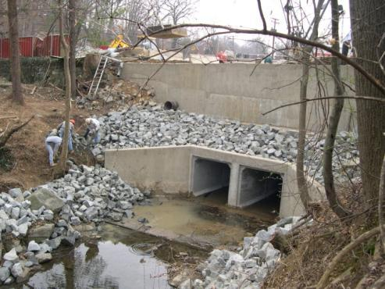
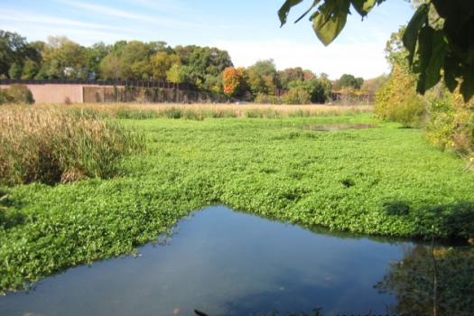
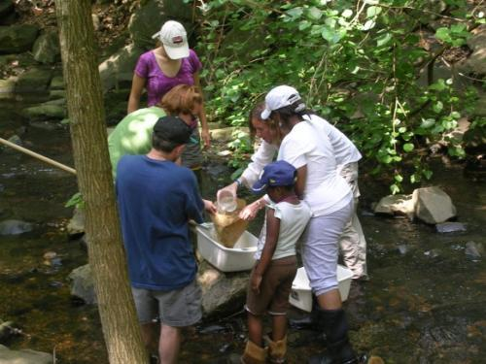
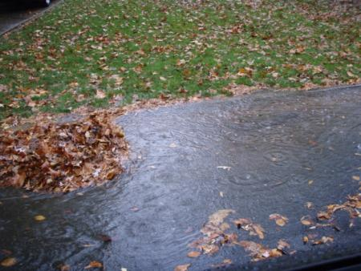
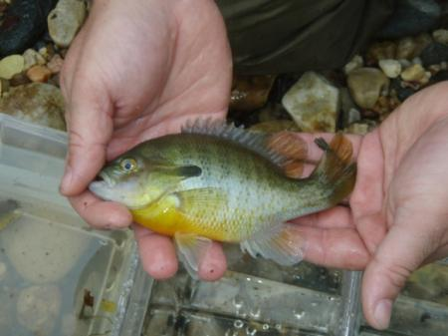
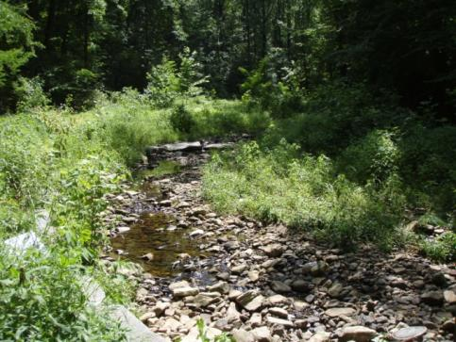
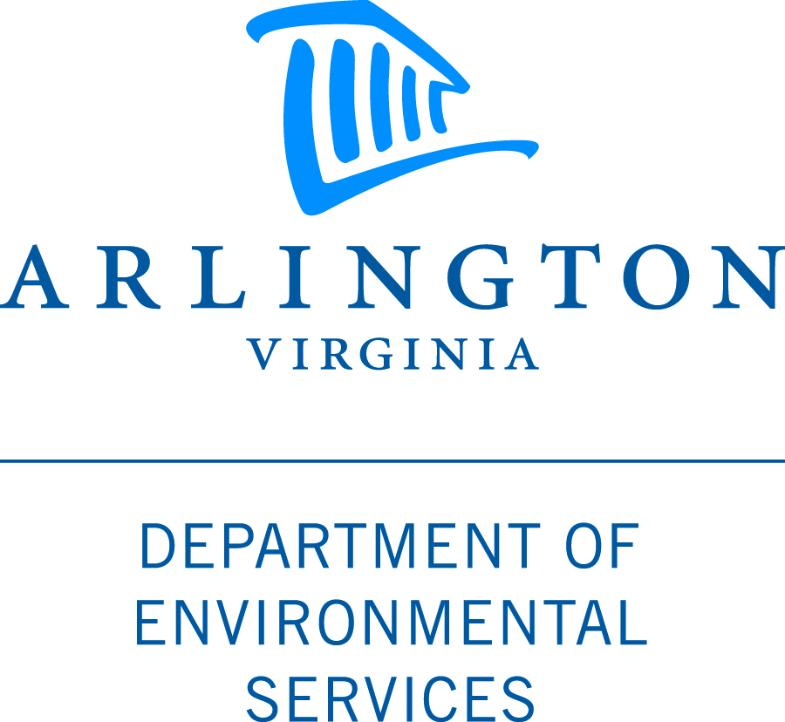
Arlington County’s Watershed
Improvement Programs
Arlington County
Civic Federation Meeting
February 7, 2012

Slide 2
Agenda
Current conditions
What is the County doing?
How are potential watershed improvement projects identified?
What can you do?

Slide 3
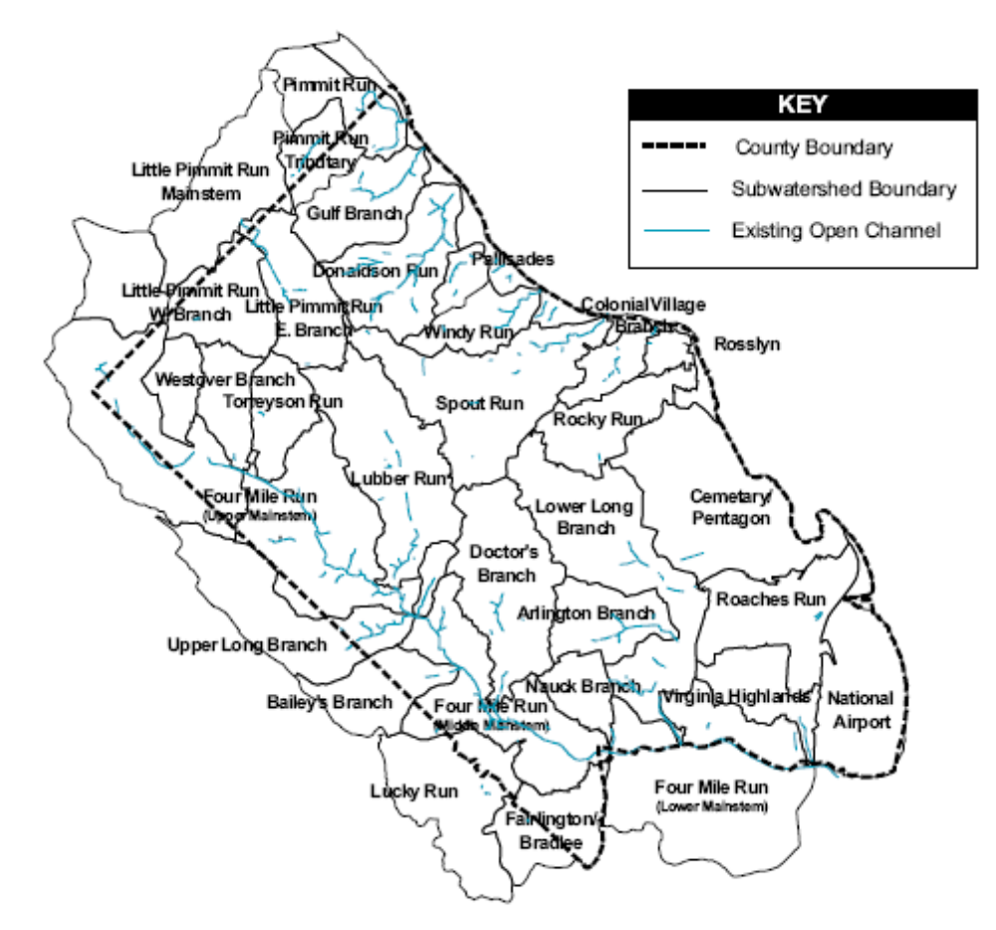
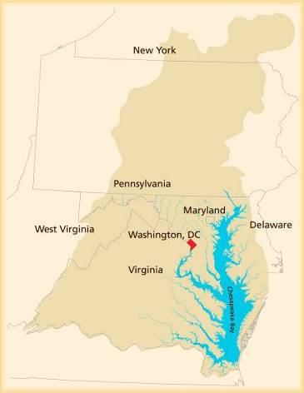
Arlington’s watersheds
Chesapeake Bay
watershed
Notes:
This map shows all the watersheds in Arlington. A watershed is an area of land that drains to a body of water. We are part of the large Chesapeake Bay watershed, which covers 64,000 square miles.

Slide 4
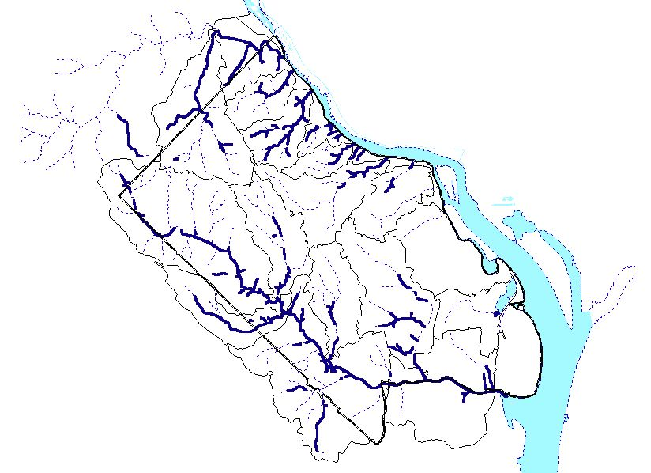
Only 28.5 miles remain of
original stream network
Notes:
Because Arlington developed before regulations protecting streams existed, we only have about 50% of our natural stream channel left.

Slide 5
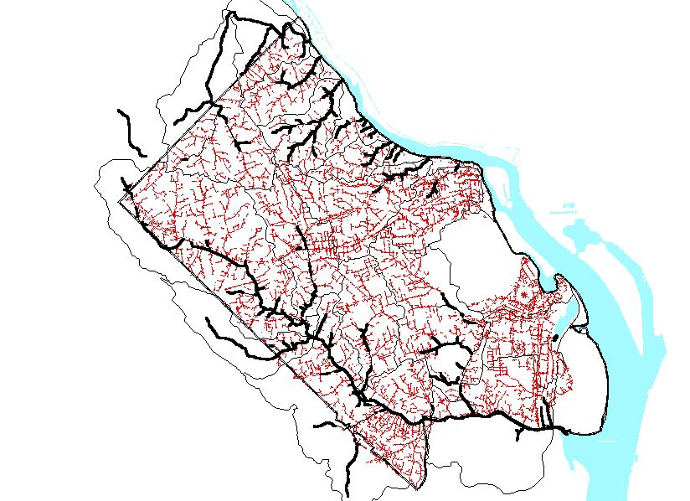
Existing
storm sewer network
= 366 miles
Notes:
This map shows the 366 mile network of storm sewer pipes.

Slide 6
Notes:
This map shows when the bulk of development occurred in Arlington – between 1930 and 1960.

Slide 7
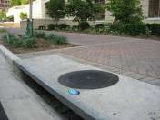
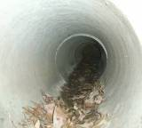
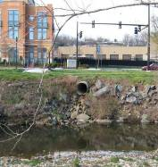
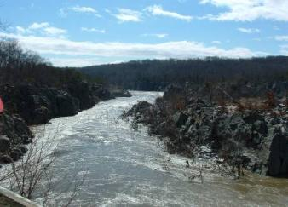
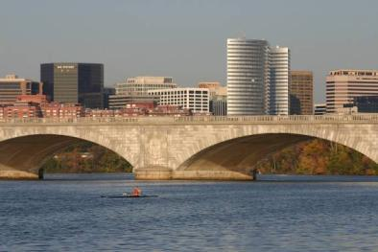
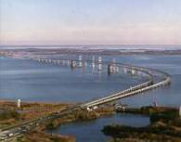
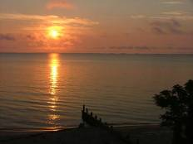
Most of Arlington’s stormwater flows through storm sewer pipes directly to local streams, then flows down the Potomac River to the Chesapeake Bay
Water in storm drains does not go to a treatment plant!
Notes:
In Arlington we have a separate storm sewer system from our sanitary sewer system. This means that all the water that runs off streets and yards goes into storm drains, and directly to our streams. This water is not treated at a wastewater treatment plant.

Slide 8
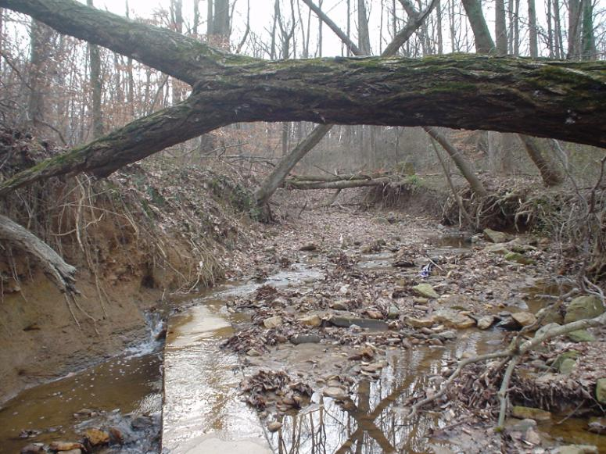
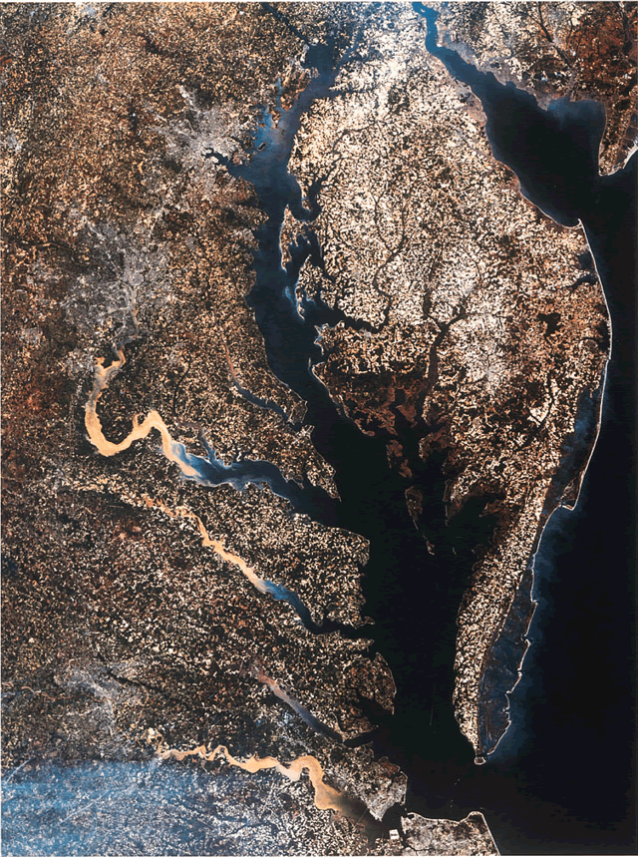
Water Quality Impacts from
Stormwater Runoff
Potomac River is our source of drinking water.
Stormwater runoff erodes local streams, carries sediment, nutrients, and litter downstream, kills trees, affects habitat for aquatic organisms, and damages sewer lines.
Sediment and nutrients are major pollutants of concern for Chesapeake Bay.
Notes:
Here you can see some of the impacts that stormwater has had on our local streams. This is not unique to Arlington.
This image of the Chesapeake Bay shows the sediment that is washing into the Bay after a rain storm. Sediment is considered a major pollutant for the Bay.
We should also note that the Potomac River is our source of drinking water.

Slide 9
Current Stormwater Challenges
Existing Development
  Most of Arlington was developed before stormwater regulations existed, so County streams are heavily impacted by stormwater runoff.
More stringent regulations
  Required to reduce water pollution and protect Chesapeake Bay.
Aging Infrastructure
  More than half of the storm sewer network is over 50 years old.
System Capacity
  Needs to be sufficient to reduce flood risks to an acceptable level.
Climate change
  Climate models predict frequency of heavy rainfall events could increase.
Notes:
Here are some of the main challenges we are dealing with related to stormwater.
The biggest challenge we face is existing development. Many people focus on new development, but our streams have been heavily impacted by development which was built before there were requirements for stormwater controls.
Regulations are also changing and becoming more stringent.
Our storm sewer system is aging, with over half of the system more than 50 years old. The pipes have a 50-75 year lifespan.
We want to ensure that the system capacity is sufficient to reduce flood risks to an acceptable level.
Climate change.

Slide 10

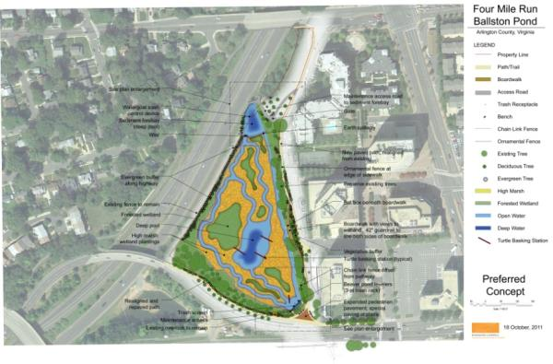
Improve Existing Stormwater Facilities
Ballston Pond - Redesign of existing stormwater pond is underway to enhance nutrient and sediment removal and improve water quality.
Pond will treat ~ 400 acres of impervious area that drain to Four Mile Run.
Notes:
In response to those challenges, the County has developed a number of strategies to improve local streams and better manage stormwater.
One of those is to improve our existing stormwater facilities. With limited space, we want to make sure these facilities are operating at their peak capacity.

Slide 11
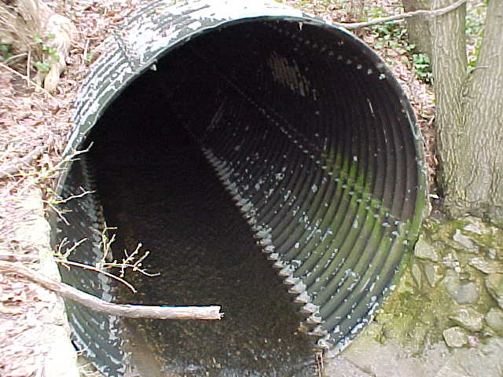
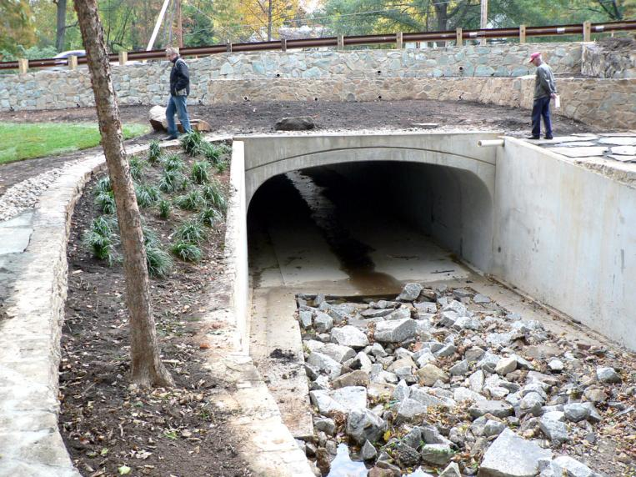
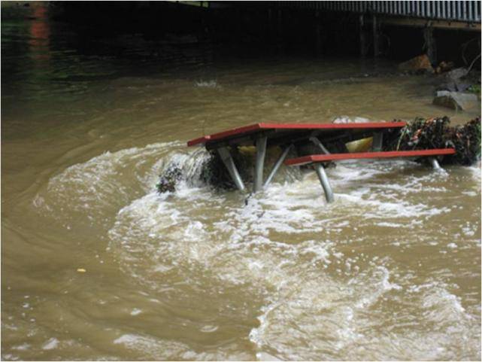
Upgrade Infrastructure
Reduce Flooding Risks
Notes:
We are also reviewing our existing infrastructure, to see what needs to be repaired or replaced. Some of these projects also help reduce flooding risks.

Slide 12
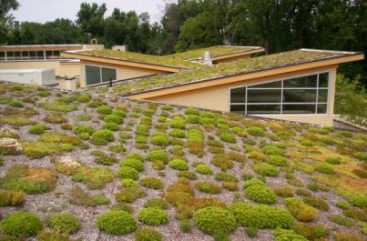
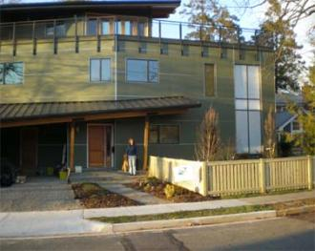
Development Controls
Chesbay ordinance strengthened in 2003 and again in 2011; governs development projects disturbing more than 2500 square feet and areas near streams.
Reduced lot coverage in 2005.
Commercial Green Building Incentive Program.
Green Home Choice Program.
LEED certification for all County projects.
Notes:
We have a number of programs that put limits on development. The Chesapeake Bay ordinance was stregthened in 2003 and again in 2011. The Board reduced the allowable lot covered in 2005. We also have several green building programs that require developers to meet green building standards, and we are also making County buildings more green.

Slide 13
Notes:
Here you can see the effect of those increased development controls. This graph shows the imperivous area, or paved/built surfaces, on residential lots. You can see the average went down after 2003.

Slide 14

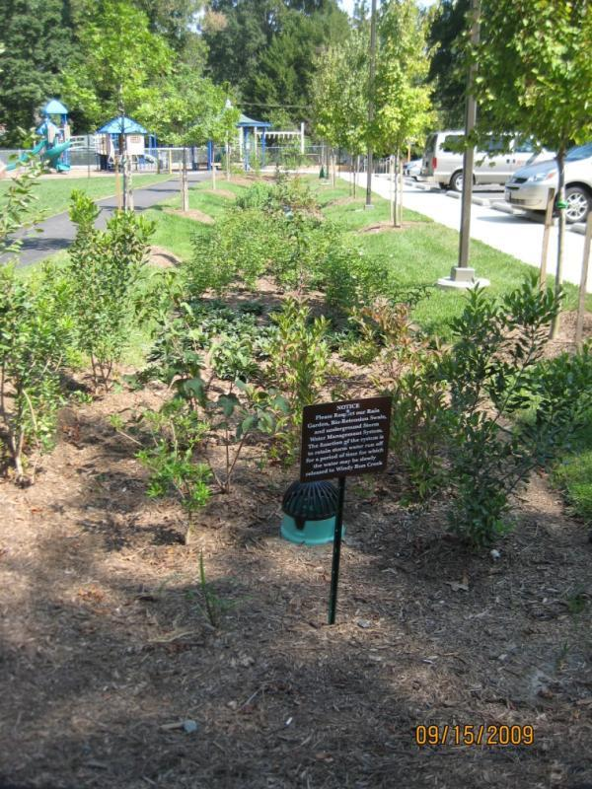
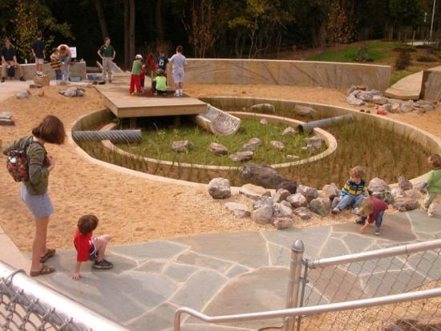
New Stormwater Facilities
Notes:
In addition to improving existing facilities, we are adding new stormwater facilities. Here is a green roof on the Walter Reed community center, and a raingarden at Powhatan springs park and at the Woodmont Center.

Slide 15
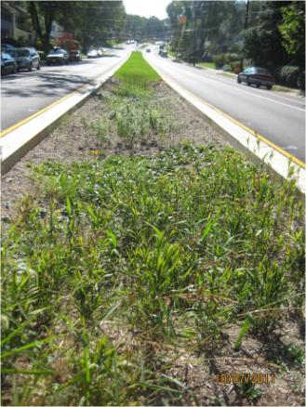
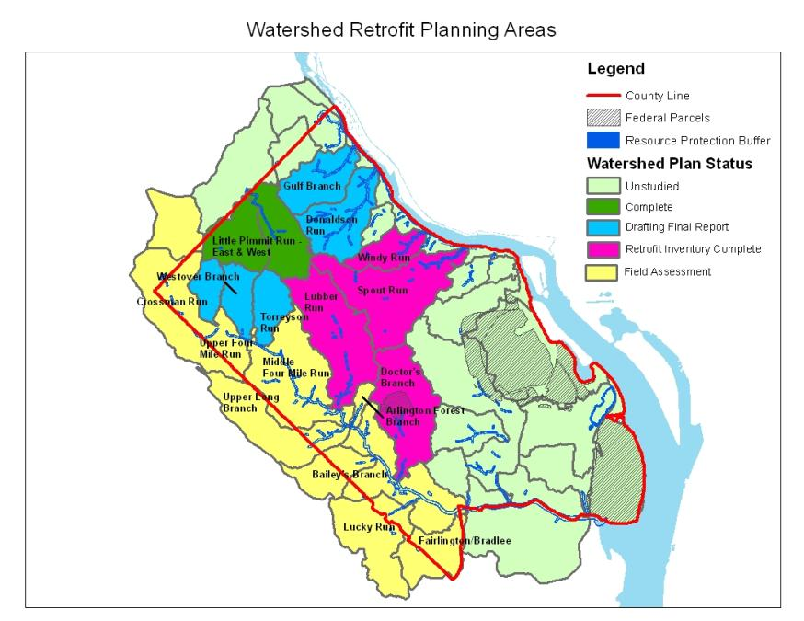
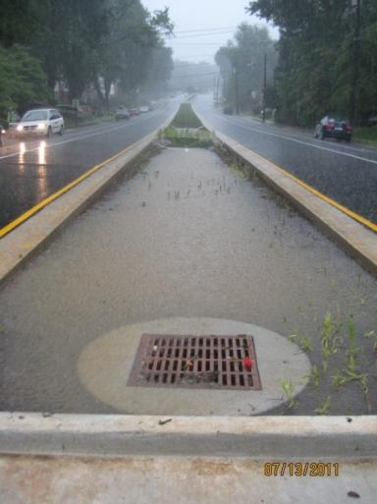
Identify Potential Stormwater Facility Sites
Watershed Retrofit Plans
Notes:
We are conducting studies of all the watersheds in the County to find locations for new stormwater facilities. Some of these may be “Green Streets” facilities, where the median or curb area is converted to filter and clean some of the stormwater. This green street is the first one completed in the County, at Patrick Henry Dr and 9th St.

Slide 16
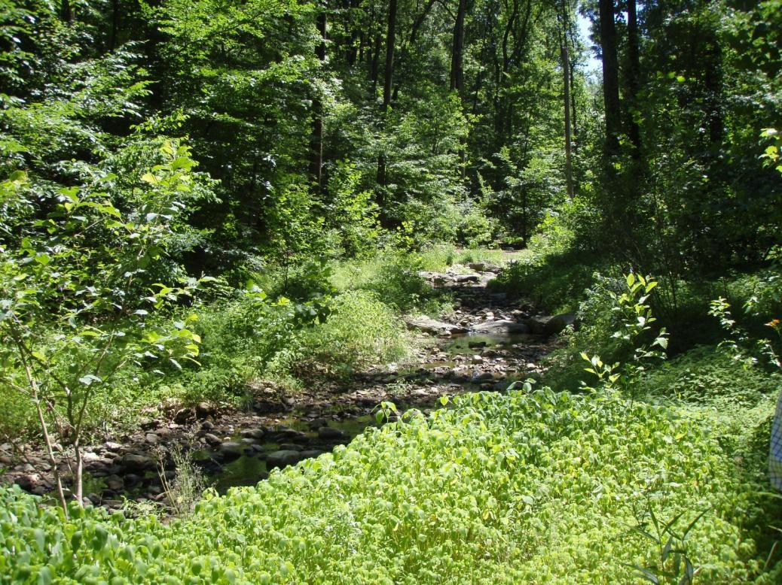

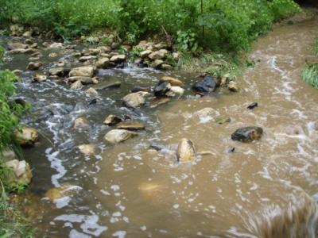
Stream Restoration
Before
After
Notes:
We are also restoring some stream channels that have suffered very severe erosion. Here you can see Donaldson Run before and after the restoration project. The photo at the bottom shows the sediment from the unrestored branch of the stream, as compared with the restored branch.

Slide 17

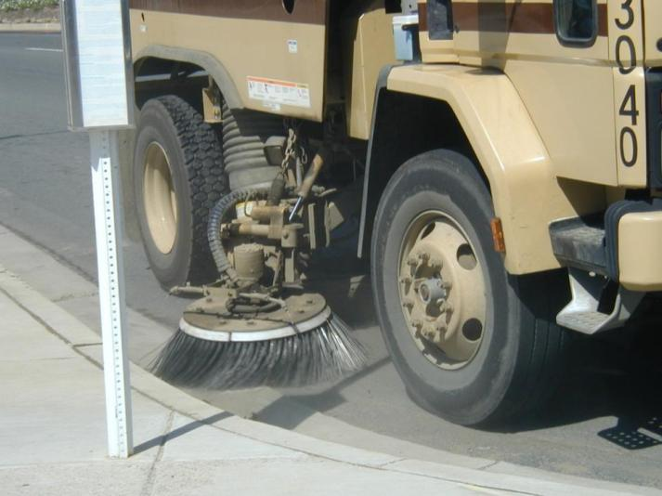
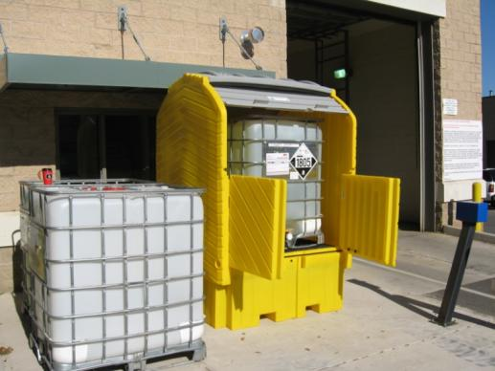
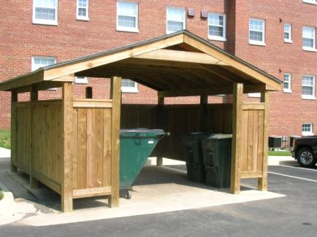
Pollution Prevention
Notes:
Another key area is pollution prevention. We are working with businesses and facilities to reduce pollution. Street Sweeping also helps remove lots of pollutants before they wash into the stream.

Slide 18
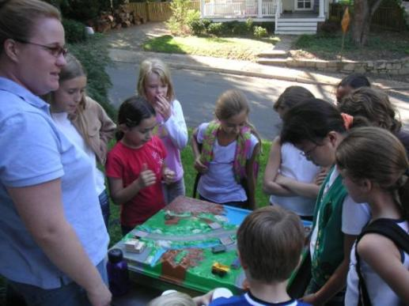

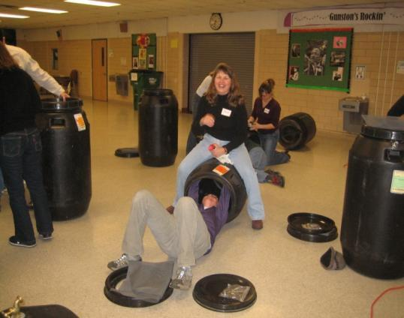
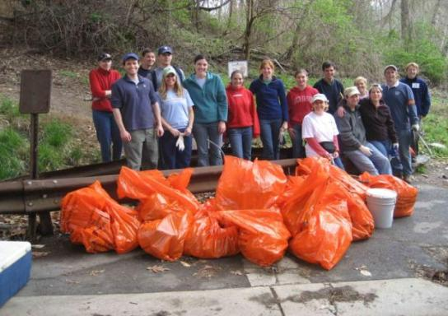

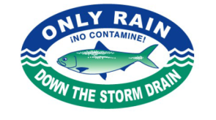
Outreach and Education
Notes:
We have many outreach and education programs as well to help residents understand these issues and get involved. I’ll talk more about this in a few minutes.

Slide 19
How are Potential Watershed Improvement Projects Identified?
Stormwater Master Plan (1996) and Watershed Management Plan (2001) are being updated and combined into a comprehensive Stormwater Master Plan (to be completed in 2012).
  Storm Sewer Capacity Analysis to study the County's current storm sewer pipes.
  County-wide stream inventory to assess stream conditions and prioritize stream restoration projects.
  Watershed retrofit plans to identify locations where stormwater treatment facilities can be added to help slow down and filter stormwater runoff.
Notes:
Currently, we are working on an update to the County’s Stormwater Master Plan that will help us identify future projects. This plan includes an analysis of the storm sewer system and its capacity, a stream inventory of County stream conditions, and the watershed studies I mentioned earlier.

Slide 20
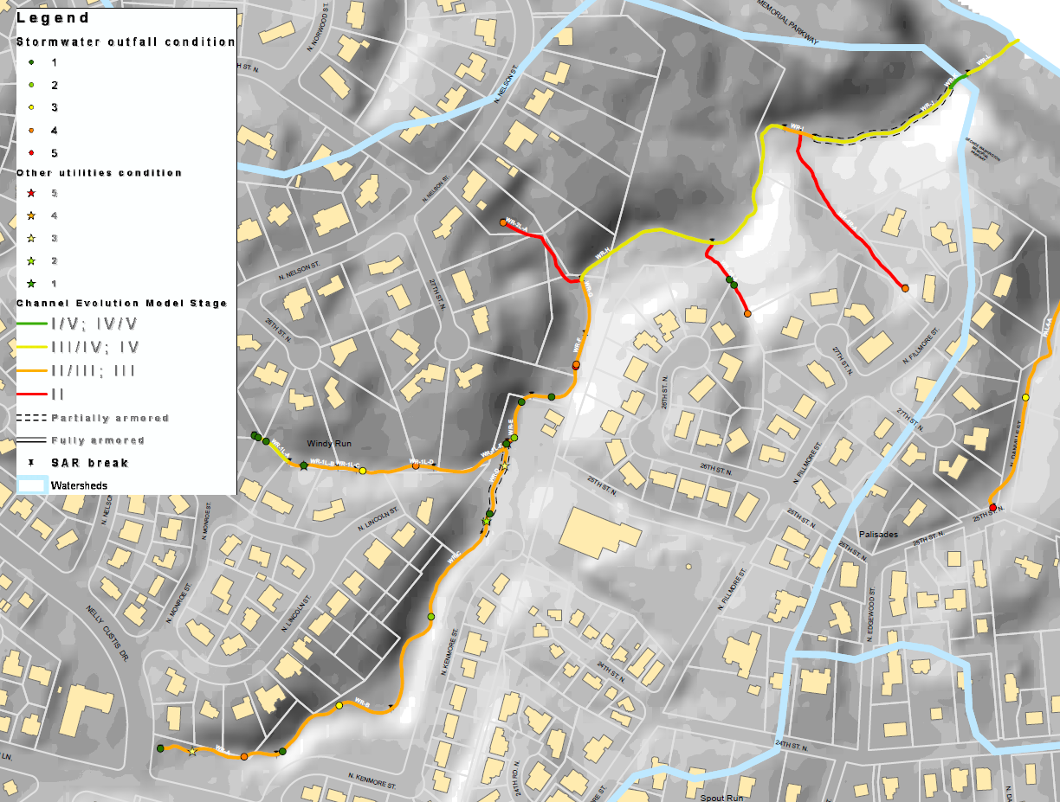
Windy Run example
Notes:
This map is an example that shows how we are using the stream assessment data. Information on the stream channel conditions and the condition of any infrastructure is mapped. The colored lines are the stream channels, and the infrastructure is shown by the stars and circles.

Slide 21
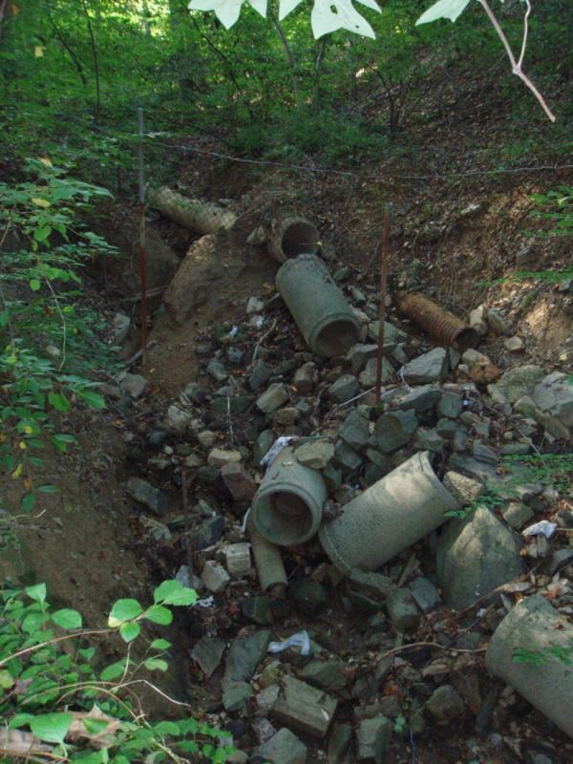
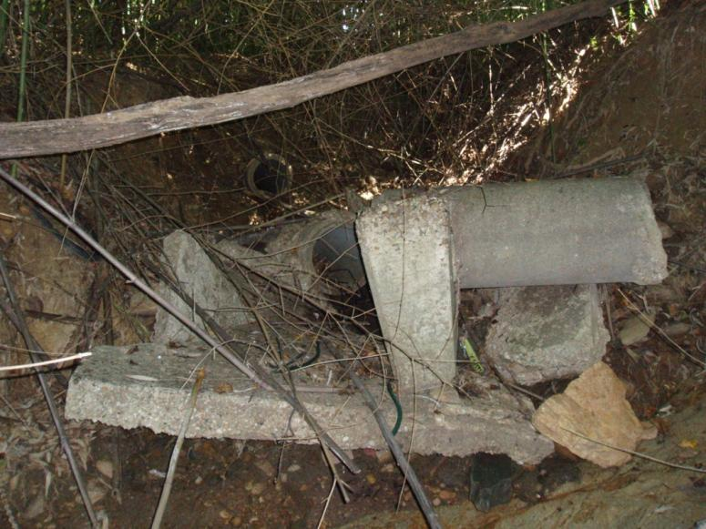
n=412
35 stormwater outfalls with
severity score 4 or 5
Notes:
Here are some examples of infrastructure in the streams. All the storm sewer outfalls in the streams were evaluated and rated, and you can see that about 35 of them were rated as in very poor condition.

Slide 22
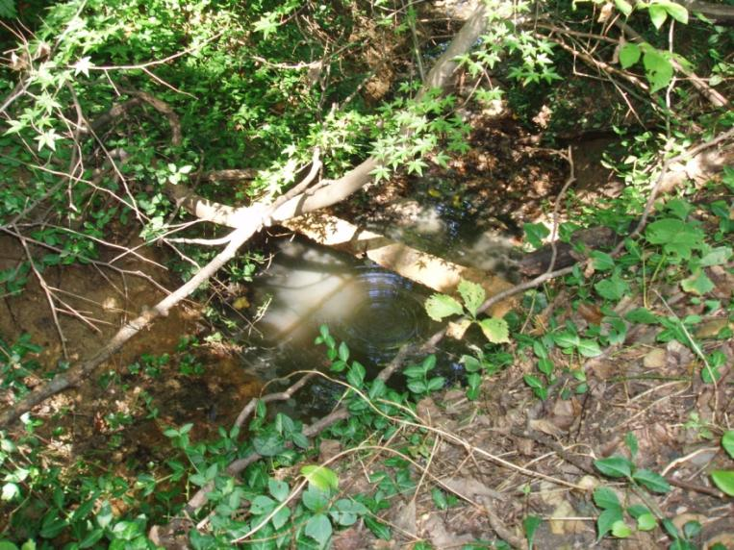
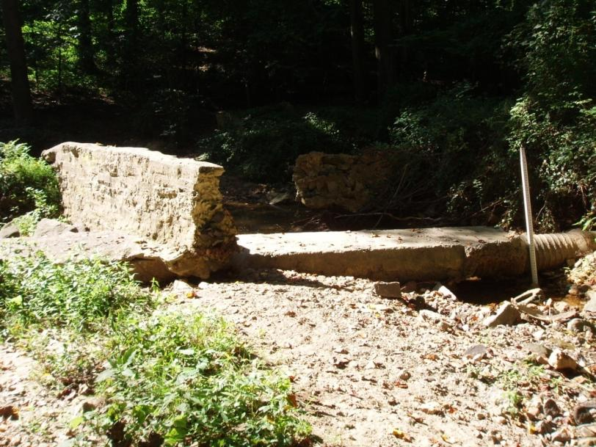
n=107
13 sanitary sewer lines with severity score 4 or 5
Notes:
Also there are sanitary sewer lines that cross some stream channels. The condition of these pipes was also rated. 13 of them scored in the worst condition.

Slide 23
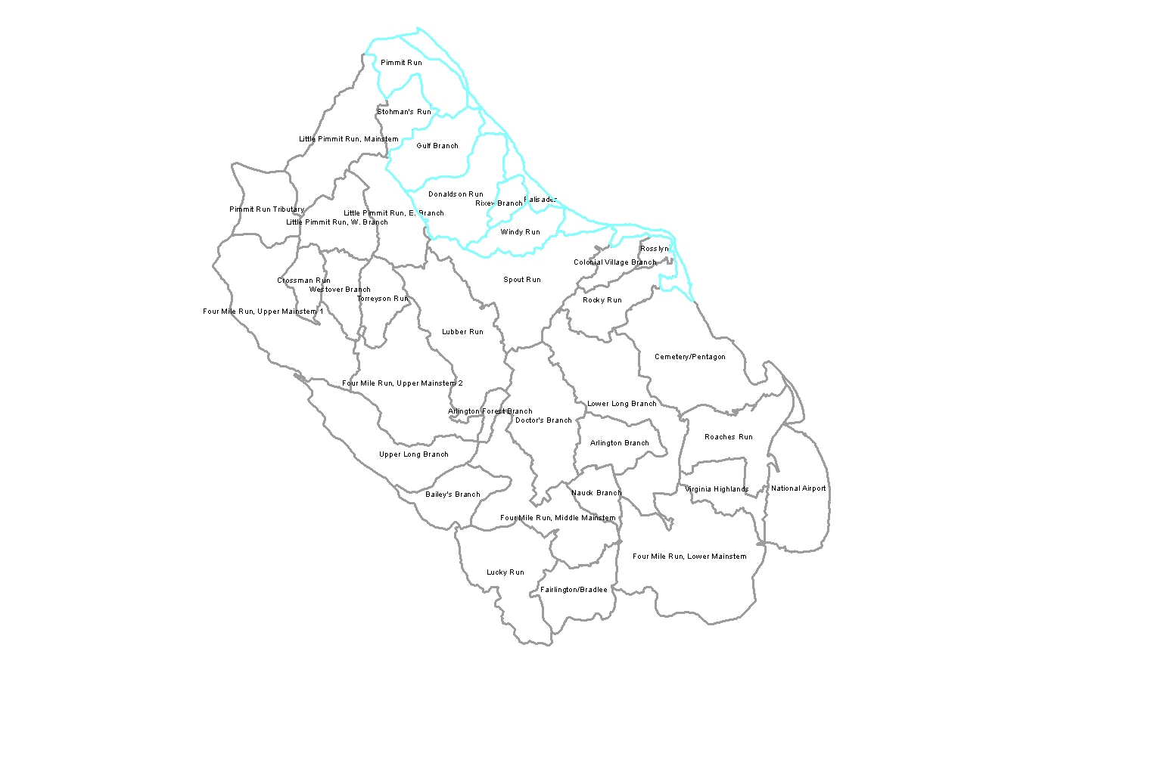
Priority Watersheds by Channel & Infrastructure Condition
Gulf Branch
Windy Run
Donaldson Run
Pimmit Run
Palisades
Notes:
This map summarizes the stream channel and infrastructure results, so we can see what watersheds are in the worst condition.

Slide 24
What Can You Do?
Reduce Runoff
  Collect and reuse rainwater
  Re-direct downspouts
  Reduce impervious cover
Prevent Pollution
Use Native Plants
Report Stream Pollution
Get Involved!
Help Spread the Word!

Slide 25
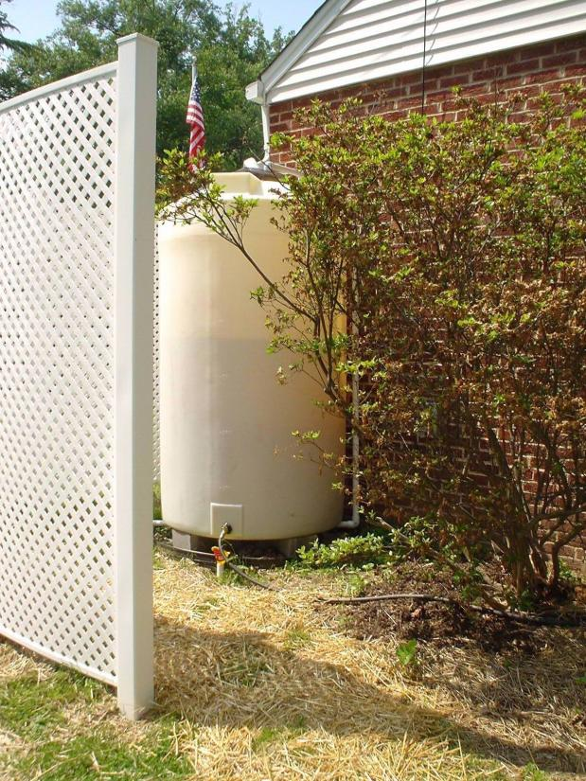
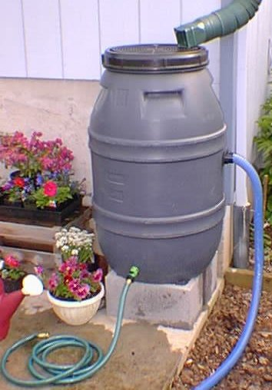
Collect rainwater for reuse around your yard

Slide 26
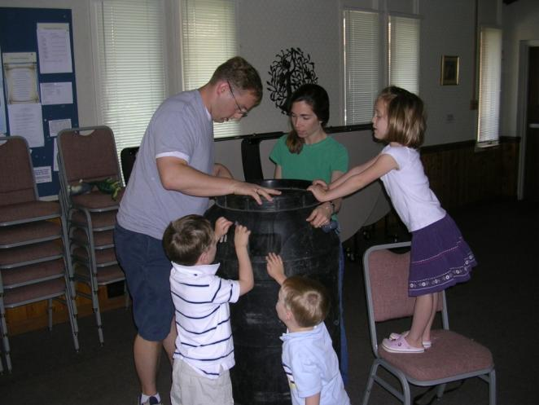
Where to get a rain barrel?
NoVa Regional Rain Barrel Program – spring workshops are open!
http://www.arlingtonenvironment.org/barrel.php

Slide 27
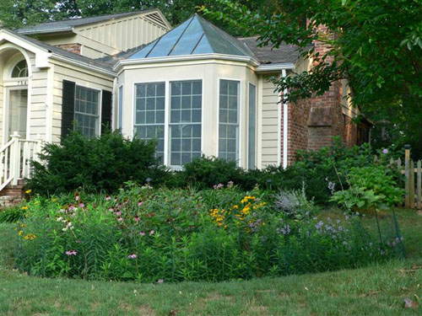

Re-direct Downspouts to Garden Beds or a Raingarden
Notes:
Mention that we have low cost rain barrel program, raingarden trainings, and are working on incentive program.

Slide 28


Reduce Impervious Areas
Pervious Paver Driveway
Grass Driveway

Slide 29
StormwaterWise Landscape Program
StormwaterWise Landscapes Incentive Program Pilot program begins 2012!
40 participants will be selected for the first year of the program.
Applications are due February 29!
Program in partnership with Arlingtonians for A Clean Environment.
www.arlingtonva.us/stormwaterwise

Slide 30



Use Native Plants
Better adapted to our climate
Support local wildlife
Beautiful!

Slide 31
Prevent Pointless Pollution!
Always pick up pet waste!
Dispose of used motor oil and household hazardous waste (paint, batteries, household cleaners, etc.) properly. (ECARE April 7)
Avoid fertilizer or pesticide use – try compost instead!
Wash your car at a commercial carwash, or in a location where the soapy water will not run into the storm drain.
Sweep up dirt, grass clippings, other yard waste instead of washing them down the driveway and into the gutter.

Slide 32


How to Report Stream Pollution?
To report stream pollution: 703-558-2222
Active or on-going spills or illegal dumping of any kind should be reported to the Arlington County Emergency Communications (ECC). An engine company and/or a Hazardous Materials Team will be sent to investigate immediately.

Slide 33





Get Involved!
Volunteer programs:
  Stream Monitoring
  Bacteria Monitoring
  Stream Cleanups
  Storm Drain Marking

Slide 34


Stream Monitoring Data Online

Slide 35
Questions?
Jeff Harn
Office of Sustainability and Environmental Management, Department of Environmental Services
jharn@arlingtonva.us
Aileen Winquist
Watershed Outreach Program Manager
awinquist@arlingtonva.us
Event dates for programs – freshaireva.us

